Slide 1
Lesson 5
Laravel-
Creating First Page
[Controllers and Views]

Slide 2
Laravel Basic Routing
Routing is one of the essential concepts in Laravel.
The main functionality of the routes is to route all your application requests to the appropriate controller.

Slide 3
Default Route files
All Laravel routes are defined inside the route files located in the routes directory.
When we create a project, then a route directory is created inside the project.
The route/web.php directory contains the definition of route files for your web interface.
The routes in web.php are assigned with the web middleware group that provides the features like session state and CSRF protection.
The routes defined in routes/api.php are assigned with the API middleware group, and they are stateless.

Slide 4
Default Route files(cont.)
We will start by defining the routes in routes/web.api file.
The routes defined in the routes/web.php can be accessed by entering the defined URL to the browser.
Let's understand this through an example.
The definition of default route files.
<?php
Route::get('/', function ()
{
return view ('welcome');
});

Slide 5
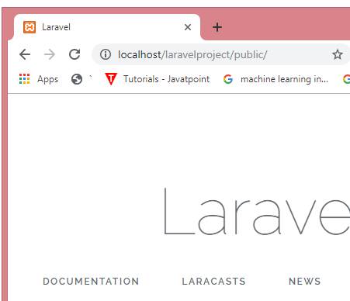
Default Route files(cont.)
In the above case, Route is the class which defines the static method get().
The get() method contains the parameters '/' and function() closure. The '/' defines the root directory and function() defines the functionality of the get() method.
In the above route, the url is '/'; therefore, we entered the localhost/laravelproject/public URL in the web browser.
Output:

Slide 6
Returning Hello TUM
<?php
Route::get('/example', function ()
{
return "Hello TUM";
});
Output:

Slide 7
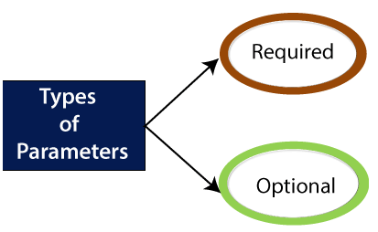
Laravel Routing Parameters
There are two types of parameters we can use:
Required Parameters
Optional Parameters

Slide 8
Required Parameters
The required parameters are the parameters that we pass in the URL.
Sometimes you want to capture some segments of the URI then this can be done by passing the parameters to the URL. For example, you want to capture the user id from the URL.

Slide 9
Required Parameters(cont.)
<?php
Route::get('/', function()
{
return "This is a home page";
}
);
Route::get('/about', function()
{
return "This is a about us page";
}
);
Route::get('/contact', function()
{
return "This is a contact us page";
}
);

Slide 10
Required Parameters(cont.)
<?php
Route::get('/', function()
{
return "This is a home page";
}
);
Route::get('/about', function()
{
return "This is a about us page";
}
);
Route::get('/contact', function()
{
return "This is a contact us page";
}
);

Slide 11
Route Parameters
Route::get('/post/{id}', function($id)
{
return "id number is : ". $id;
}
);

Slide 12
Route Parameters
The route parameters are enclosed within {} brackets, and parameters must contain alphabetic characters.
It should not contain '-' character, and instead of using this character, you can use '_' character

Slide 13
Route Parameters(cont.)
Route::get('/post/{id}', function($id)
{
return "id number is : ". $id;
}
);

Slide 14
Route Parameters(cont.)
//We can also pass the multiple parameters.
Route::get('/post/{id}/{name}', function($id,$name)
{
return "id number is : ". $id ." ".$name;
}
);

Slide 15
Optional Parameters
Suppose you want to specify the route parameter occasionally, in order to achieve this, you can make the route parameter optional.
To make the route parameter optional, you can place '?' operator after the parameter name.
If you want to provide the optional parameter, and then make sure that you have also provided the default value to the variable.
Let's understand through some examples.

Slide 16
Optional Parameters(cont.)
Route::get('user/{name?}', function ($name=null) {
return $name;
});

Slide 17
Optional Parameters(cont.)
Route::get('user/{name?}', function ($name = 'himani') {
return $name;
});

Slide 18
Regular Expression Constraints
These are the constraints that can format the route parameters by using the where method on a route instance.
The 'where' method accepts the name of the parameter and regular expression constraint that defines how the parameter should be constrained.

Slide 19
Regular Expression Constraints(cont.)
Let's understand through some examples.
Example 1:
Suppose we want to pass the user name as a route parameter that contains only alphabetical characters.
Route::get('user/{name?}', function ($name=null) {
return $name;
})->where('name','[a-zA-Z]+');

Slide 20
Regular Expression Constraints(cont.)
Let's consider an example that accepts only numeric values.
Route::get('user/{id?}', function ($id=null) {
return "id is : ". $id;
}->where('id','[0-9]+');

Slide 21
Regular Expression Constraints(cont.)
Let's consider an example that accepts alphanumeric characters.
Route::get('user/{id}/{name}', function ($id,$name) {
return "id is : ". $id ." ,". "Name is : ".$name ;
})->where(['id'=>'[0-9]+', 'name'=>'[a-zA-Z]+']);

Slide 22
app-routes:web.php
<?php
use Illuminate\Support\Facades\Route;
/*
| Web Routes
*/
Route::get('/', function () {
return view('welcome');
});

Slide 23
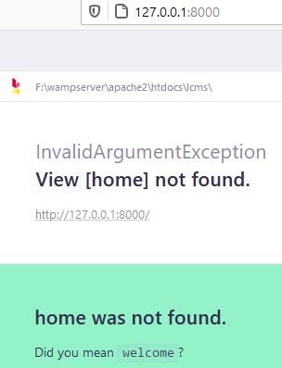
Change welcome to home
Route::get('/', function () {
return view('home');
});
start the server
PS F:\wampserver\apache2\htdocs\lcms> php artisan serve
Starting Laravel development server: http://127.0.0.1:8000
[Sat May 15 10:26:21 2021] PHP 8.0.6 Development Server (http://127.0.0.1:8000) started

Slide 24
Create a home Page
<!DOCTYPE html>
<html>
<body>
<h1>Home Page</h1>
<p>Welcome to Home Page.</p>
</body>
</html>

Slide 25
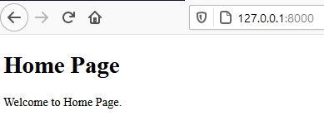
Routing: Returning a View
//Route that sends back a view
Route::get('/', function () {
return view('home');
});

Slide 26

Routing: Returning a String
www.tum.ac.ke ==/
www.tum.ac.ke/users ==/users
Route::get('/users', function () {
return ’Welcome to users Page’;
});
start the server
PS F:\wampserver\apache2\htdocs\lcms> php artisan serve
Starting Laravel development server: http://127.0.0.1:8000

Slide 27

Routing: Returning an Array
//Route to Users-sends back an Array
Route::get('/users', function () {
return ['HTML','PHP','CSS'];
});

Slide 28
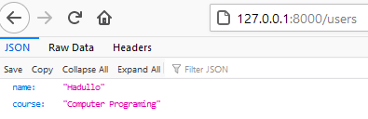
Routing: Returning a JSON Object
//Route to Users-JSON Object
Route::get('/users', function () {
return response()->json([
'name' => 'Hadullo',
'course' => 'Computer Programing'
]);
});

Slide 29
Types of Routes
//Route to Users-sends back a string
Route::get('/users', function () {
return 'Welcome to the users Page';
});
//Route to Users-sends back an Array
Route::get('/users', function () {
return ['HTML','PHP','CSS'];
});
//Route to Users-JSON Object
Route::get('/users', function () {
return response()->json([
'name' => 'Hadullo',
'course' => 'Computer Programing'
]);
});

Slide 30
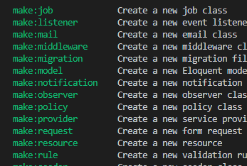
php artisan list command
Lists all the commands in Laravel

Slide 31
How to Create a new Controller called ProductsController
All controllers are based on the base controller found on the Controller.php file
Lets create a new Controller called ProductsController

Slide 32
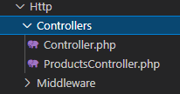
Step 1:Creating a new Controller(cont.)
php artisan make:controller ProductsController
PS F:\wampserver\apache2\htdocs\lcms> php artisan make:controller ProductsController
Controller created successfully.
PS F:\wampserver\apache2\htdocs\lcms>

Slide 33
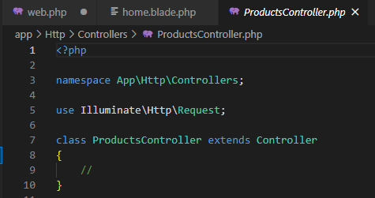
Creating a new Controller(cont.)

Slide 34
Step 2: Add the link to the Controller in the web.php File
<?php
use Illuminate\Support\Facades\Route;
//Link to the Controller
use App\Http\Controllers\ProductsController;
/*
| Web Routes
|------------------------------------------------------*/
Route::get('/', function () {
return view('home');
});

Slide 35
Step 3: Rewrite the Code in web.php File as shown
<?php
use Illuminate\Support\Facades\Route;
//Link to the Controller
use App\Http\Controllers\ProductsController;
/*
| Web Routes
|------------------------------------------------------*/
Route::get('/products', [ProductsController::class, 'index']);

Slide 36
Step 4: add the function "index” to the ProductsController
<?php
namespace App\Http\Controllers;
use Illuminate\Http\Request;
class ProductsController extends Controller
{
public function index()
return view();
}

Slide 37
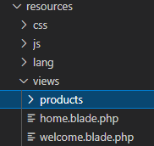
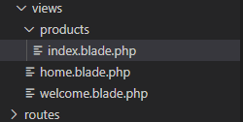
Step 5: Add the products Folder to the views Directory
Add a new File:index.blade.php in products

Slide 38
Step 6: Create index File in products Directory
<!DOCTYPE html>
<html>
<body>
<h1>products</h1>
<p>My Products.</p>
</body>
</html>

Slide 39
Step 7: Edit the ProductsController as Shown
<?php
namespace App\Http\Controllers;
use Illuminate\Http\Request;
class ProductsController extends Controller
{
public function index(){
return view('products.index');
}
}

Slide 40
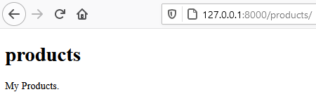
Step 8: Run the Server

Slide 41
Option 2: web.php File
// Method 1
//Route::get('/products', [ProductsController::class, 'index']);
//Method 2
Route::get('/products','App\Http\Controllers\ProductsController@index');

Slide 42
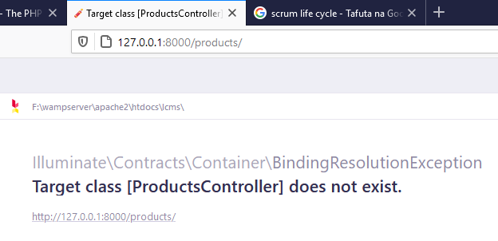
Option 3: web.php File
// Method 3-Before Laravel 8
Route::get('/products', 'ProductsController@index');
This does not work anymore and brings an error

Slide 43
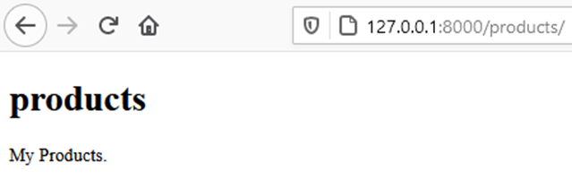
Always use Method 1
// Method 1
Route::get('/products', [ProductsController::class, 'index']);

Slide 44
Adding About Page for Products
Edit web.php File
// Method 1
Route::get('/products', [ProductsController::class, 'index']);
// Method 1
Route::get('/products/about', [ProductsController::class, 'about']);

Slide 45
Create about Page
about.blade.php
<!DOCTYPE html>
<html>
<body>
<h1>About Us</h1>
<p>About Our Products.</p>
</body>
</html>

Slide 46
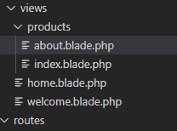
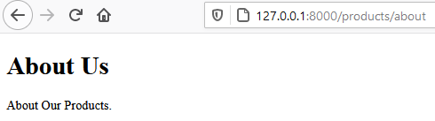
Create about Page
about.blade.php

Slide 47
The end Thank you

